Slide 1
Cryptography and Network Security Chapter 12
Fourth Edition
by William Stallings
Lecture slides by Lawrie Brown
Notes:
Lecture slides by Lawrie Brown for “Cryptography and Network Security”, 4/e, by William Stallings, Chapter 12 – “Hash and MAC Algorithms”.

Slide 2
Chapter 12 – Hash and MAC Algorithms
Each of the messages, like each one he had ever read of Stern's commands, began with a number and ended with a number or row of numbers. No efforts on the part of Mungo or any of his experts had been able to break Stern's code, nor was there any clue as to what the preliminary number and those ultimate numbers signified.
—Talking to Strange Men, Ruth Rendell
Notes:
Opening quote.

Slide 3
Hash and MAC Algorithms
Hash Functions
condense arbitrary size message to fixed size
by processing message in blocks
through some compression function
either custom or block cipher based
Message Authentication Code (MAC)
fixed sized authenticator for some message
to provide authentication for message
by using block cipher mode or hash function
Notes:
Now look at important examples of both secure hash functions and message authentication codes (MACs).
Traditionally, most hash functions that have achieved widespread use rely on a compression function specifically designed for the hash function. Another approach is to use a symmetric block cipher as the compression function.
MACs also fall into two categories: some use a hash algorithm such as SHA as the core of the MAC algorithm, others use a symmetric block cipher in a cipher block chaining mode.

Slide 4
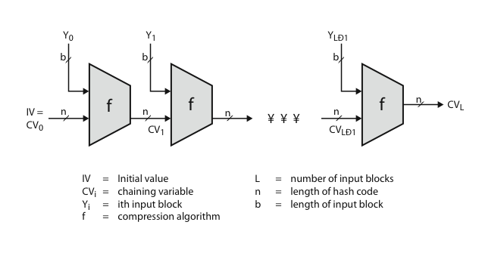
Hash Algorithm Structure
Notes:
Most important modern hash functions follow the basic structure shown in this figure, Stallings Figure 11.9. This has proved to be a fundamentally sound structure, and newer designs simply refine the structure and add to the hash code length. Within this basic structure, two approaches have been followed in the design of the compression function, as mentioned previously, which is the basic building block of the hash function.

Slide 5
Secure Hash Algorithm
SHA originally designed by NIST & NSA in 1993
was revised in 1995 as SHA-1
US standard for use with DSA signature scheme
standard is FIPS 180-1 1995, also Internet RFC3174
nb. the algorithm is SHA, the standard is SHS
based on design of MD4 with key differences
produces 160-bit hash values
recent 2005 results on security of SHA-1 have raised concerns on its use in future applications
Notes:
The Secure Hash Algorithm (SHA) was developed by the National Institute of Standards and Technology (NIST) and published as a federal information processing standard (FIPS 180) in 1993; a revised version was issued as FIPS 180-1 in 1995 and is generally referred to as SHA-1. The actual standards document is entitled Secure Hash Standard. SHA is based on the hash function MD4 and its design closely models MD4. SHA-1 produces a hash value of 160 bits. In 2005, a research team described an attack in which two separate messages could be found that deliver the same SHA-1 hash using 2^69 operations, far fewer than the 2^80 operations previously thought needed to find a collision with an SHA-1 hash [WANG05]. This result should hasten the transition to newer, longer versions of SHA.

Slide 6
Revised Secure Hash Standard
NIST issued revision FIPS 180-2 in 2002
adds 3 additional versions of SHA
SHA-256, SHA-384, SHA-512
designed for compatibility with increased security provided by the AES cipher
structure & detail is similar to SHA-1
hence analysis should be similar
but security levels are rather higher
Notes:
In 2002, NIST produced a revised version of the standard, FIPS 180-2, that defined three new versions of SHA, with hash value lengths of 256, 384, and 512 bits, known as SHA-256, SHA-384, and SHA-512. These new versions have the same underlying structure and use the same types of modular arithmetic and logical binary operations as SHA-1, hence analyses should be similar. In 2005, NIST announced the intention to phase out approval of SHA-1 and move to a reliance on the other SHA versions by 2010. See Stallings Table12.1 for comparative details of these algorithms.

Slide 7
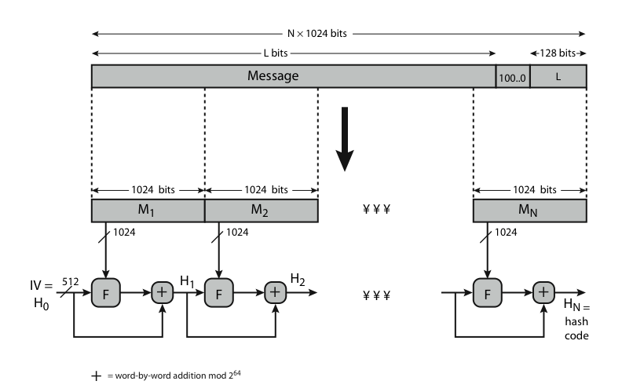
SHA-512 Overview
Notes:
Now examine the structure of SHA-512, noting that the other versions are quite similar.
SHA-512 follows the structure depicted in Stallings Figure 12.1. The processing consists of the following steps:
• Step 1: Append padding bits
• Step 2: Append length
• Step 3: Initialize hash buffer
• Step 4: Process the message in 1024-bit (128-word) blocks, which forms the heart of the algorithm
• Step 5: Output the final state value as the resulting hash
See text for details.

Slide 8
SHA-512 Compression Function
heart of the algorithm
processing message in 1024-bit blocks
consists of 80 rounds
updating a 512-bit buffer
using a 64-bit value Wt derived from the current message block
and a round constant based on cube root of first 80 prime numbers
Notes:
The SHA-512 Compression Function is the heart of the algorithm. In this Step 4, it processes the message in 1024-bit (128-word) blocks, using a module that consists of 80 rounds, labeled F in Stallings Figure 12, as shown in Figure 12.2. Each round takes as input the 512-bit buffer value, and updates the contents of the buffer. Each round t makes use of a 64-bit value Wt derived using a message schedule from the current 1024-bit block being processed. Each round also makes use of an additive constant Kt, based on the fractional parts of the cube roots of the first eighty prime numbers. The output of the eightieth round is added to the input to the first round to produce the final hash value for this message block, which forms the input to the next iteration of this compression function, as shown on the previous slide.

Slide 9
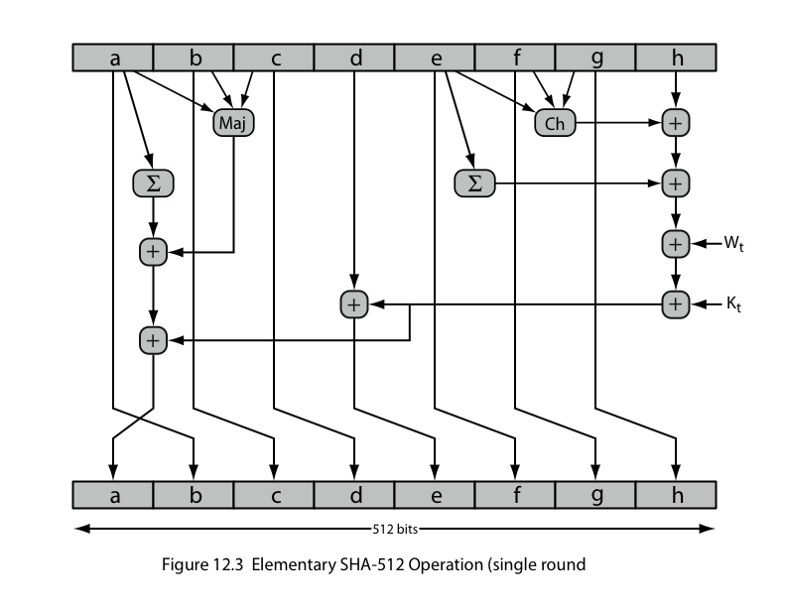
SHA-512 Round Function
Notes:
The structure of each of the 80 rounds is shown in Stallings Figure 12.3. Each 64-bit word shuffled along one place, and in some cases manipulated using a series of simple logical functions (ANDs, NOTs, ORs, XORs, ROTates), in order to provide the avalanche & completeness properties of the hash function. The elements are:
Ch(e,f,g) = (e AND f) XOR (NOT e AND g)
Maj(a,b,c) = (a AND b) XOR (a AND c) XOR (b AND c)
∑(a) = ROTR(a,28) XOR ROTR(a,34) XOR ROTR(a,39)
∑(e) = ROTR(e,14) XOR ROTR(e,18) XOR ROTR(e,41)
+ = addition modulo 2^64
Kt = a 64-bit additive constant
Wt = a 64-bit word derived from the current 512-bit input block.

Slide 10
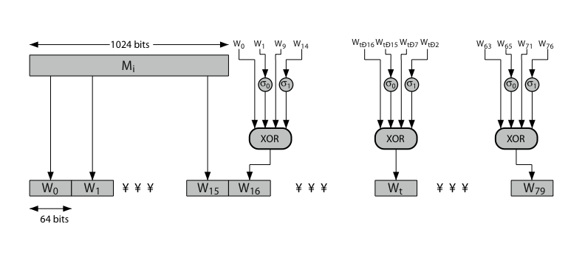
SHA-512 Round Function
Notes:
Stallings Figure 12.4 details how the 64-bit word values Wt are derived from the 1024-bit message. The first 16 values of Wt are taken directly from the 16 words of the current block. The remaining values are defined as a function of the earlier values using ROTates, SHIFTs and XORs as shown. The function elements are:
∂0(x) = ROTR(x,1) XOR ROTR(x,8) XOR SHR(x,7)
∂1(x) = ROTR(x,19) XOR ROTR(x,61) XOR SHR(x,6).

Slide 11
Whirlpool
now examine the Whirlpool hash function
endorsed by European NESSIE project
uses modified AES internals as compression function
addressing concerns on use of block ciphers seen previously
with performance comparable to dedicated algorithms like SHA
Notes:
Next examine the hash function Whirlpool [BARR03]. Whirlpool is one of only two hash functions endorsed by the NESSIE (New European Schemes for Signatures, Integrity, and Encryption) project, a European Union–sponsored effort to put forward a portfolio of strong cryptographic primitives of various types. Whirlpool is based on the use of a modified AES block cipher as the compression function, and is intended to provide security and performance that is comparable, if not better, than that found in non block-cipher based hash functions, such as the MD or SHA families.

Slide 12
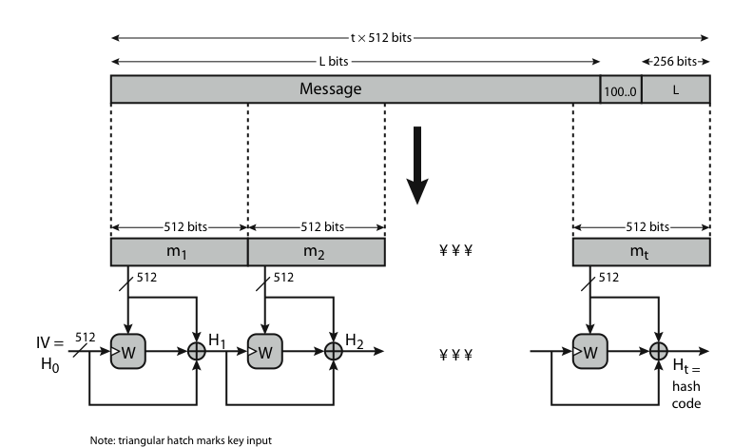
Whirlpool Overview
Notes:
Stallings Figure 12.6 shows an overview of Whirlpool, which takes as input a message with a maximum length of less than 2^256 bits and produces as output a 512-bit message digest. The input is processed in 512-bit blocks. The processing consists of the following steps:
• Step 1: Append padding bits
• Step 2: Append length
• Step 3: Initialize hash matrix
• Step 4: Process message in 512-bit (64-byte) blocks, using as its core, the block cipher W.

Slide 13
Whirlpool Block Cipher W
designed specifically for hash function use
with security and efficiency of AES
but with 512-bit block size and hence hash
similar structure & functions as AES but
input is mapped row wise
has 10 rounds
a different primitive polynomial for GF(2^8)
uses different S-box design & values
Notes:
Unlike virtually all other proposals for a block-cipher-based hash function, Whirlpool uses a block cipher that is specifically designed for use in the hash function and that is unlikely ever to be used as a standalone encryption function. The reason for this is that the designers wanted to make use of an block cipher with the security and efficiency of AES but with a hash length that provided a potential security equal to SHA-512. The result is the block cipher W, which has a similar structure and uses the same elementary functions as AES, but which uses a block size and a key size of 512 bits. See Stallings Table12.2 which compares AES and W.

Slide 14
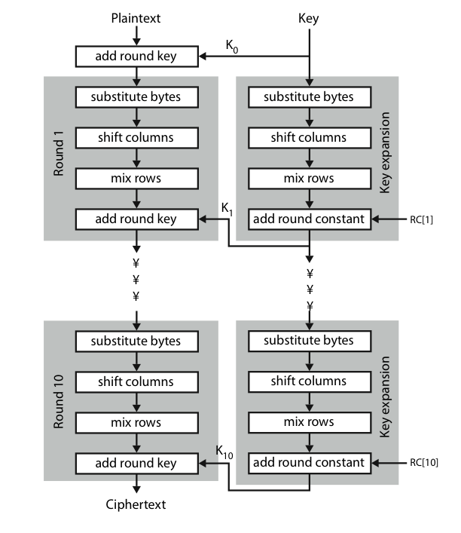
Whirlpool Block Cipher W
Notes:
Stallings Figure 12.7 shows the structure of Block Cipher W. The encryption algorithm takes a 512-bit block of plaintext as input and a 512-bit key and produces a 512-bit block of ciphertext as output. The encryption algorithm involves the use of four different functions, or transformations: add key (AK), substitute bytes (SB), shift columns (SC), and mix rows (MR). Note that the input is mapped by rows (unlike AES which is mapped by column). Hence the use of “Mix Rows” as the diffusion layer; and “Shift Columns” as the permutation (vs Mix Columns & Shift Rows in AES). Note also that the Key Schedule uses the same W round function, but with round constants RC[I] (being S-box outputs) taking the role of “subkeys” in the AddKey function.

Slide 15
Whirlpool Performance & Security
Whirlpool is a very new proposal
hence little experience with use
but many AES findings should apply
does seem to need more h/w than SHA, but with better resulting performance
Notes:
Whirlpool is a very new proposal, hence there is little experience with use, though many AES findings should apply to it. As yet, there has been little implementation experience with Whirlpool. One study [KITS04] compared Whirlpool with a number of other secure hash functions. The authors developed multiple hardware implementations of each hash function and concluded that, compared to SHA-512, Whirlpool requires more hardware resources but performs much better in terms of throughput.

Slide 16
Keyed Hash Functions as MACs
want a MAC based on a hash function
because hash functions are generally faster
code for crypto hash functions widely available
hash includes a key along with message
original proposal:
KeyedHash = Hash(Key|Message)
some weaknesses were found with this
eventually led to development of HMAC
Notes:
In recent years, there has been increased interest in developing a MAC derived from a cryptographic hash function. A hash function such as SHA was not designed for use as a MAC and cannot be used directly for that purpose because it does not rely on a secret key. There have been a number of proposals for the incorporation of a secret key into an existing hash algorithm, originally by just pre-pending a key to the message. Problems were found with these earlier, simpler proposals, but they resulted in the development of HMAC.

Slide 17
HMAC
specified as Internet standard RFC2104
uses hash function on the message:
HMAC_{K} = Hash[(K⁺ XOR opad) ||
Hash[(K⁺ XOR ipad)||M)]]
where K⁺ is the key padded out to size
and opad, ipad are specified padding constants
overhead is just 3 more hash calculations than the message needs alone
any hash function can be used
eg. MD5, SHA-1, RIPEMD-160, Whirlpool
Notes:
The idea of a keyed hash evolved into HMAC, designed to overcome some problems with the original proposals. It involves hashing padded versions of the key concatenated with the message, and then with another outer hash of the result prepended by another padded variant of the key. The hash function need only be used on 3 more blocks than when hashing just the original message (for the two keys + inner hash). HMAC can use any desired hash function, and has been shown to have the same security as the underlying hash function. Can choose the hash function to use based on speed/security concerns.

Slide 18
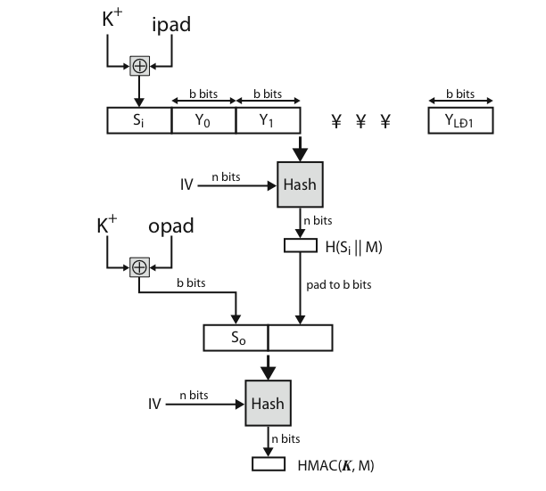
HMAC Overview
Notes:
Stallings Figure 12.10 shows the structure of HMAC, which implements the function:
HMAC_{K} = Hash[(K⁺ XOR opad) || Hash[(K⁺ XOR ipad) || M)]
elements are:
K⁺ is K padded with zeros on the left so that the result is b bits in length
ipad is a pad value of 36 hex repeated to fill block
opad is a pad value of 5C hex repeated to fill block
M is the message input to HMAC (including the padding specified in the embedded hash function)

Slide 19
HMAC Security
proved security of HMAC relates to that of the underlying hash algorithm
attacking HMAC requires either:
brute force attack on key used
birthday attack (but since keyed would need to observe a very large number of messages)
choose hash function used based on speed verses security constraints
Notes:
The appeal of HMAC is that its designers have been able to prove an exact relationship between the strength of the embedded hash function and the strength of HMAC. The security of a MAC function is generally expressed in terms of the probability of successful forgery with a given amount of time spent by the forger and a given number of message-MAC pairs created with the same key. Have two classes of attacks: brute force attack on key used which has work of order 2^n; or a birthday attack which requires work of order 2^(n/2) - but which requires the attacker to observe 2^n blocks of messages using the same key - very unlikely. So even MD5 is still secure for use in HMAC given these constraints.

Slide 20
CMAC
previously saw the DAA (CBC-MAC)
widely used in govt & industry
but has message size limitation
can overcome using 2 keys & padding
thus forming the Cipher-based Message Authentication Code (CMAC)
adopted by NIST SP800-38B
Notes:
CMAC was previously described as the Data Authentication Algorithm, FIPS PUB 113, also known as the CBC-MAC (cipher block chaining message authentication code). This cipher-based MAC has been widely adopted in government and industry. Has been shown to be secure, with the following restriction. Only messages of one fixed length of mn bits are processed, where n is the cipher block size and m is a fixed positive integer. This limitation can be overcome using multiple keys, which can be derived from a single key. This refinement has been adopted by NIST as the cipher-based message authentication code (CMAC) mode of operation, for use with AES and triple DES. It is specified in NIST Special Publication 800-38B.

Slide 21
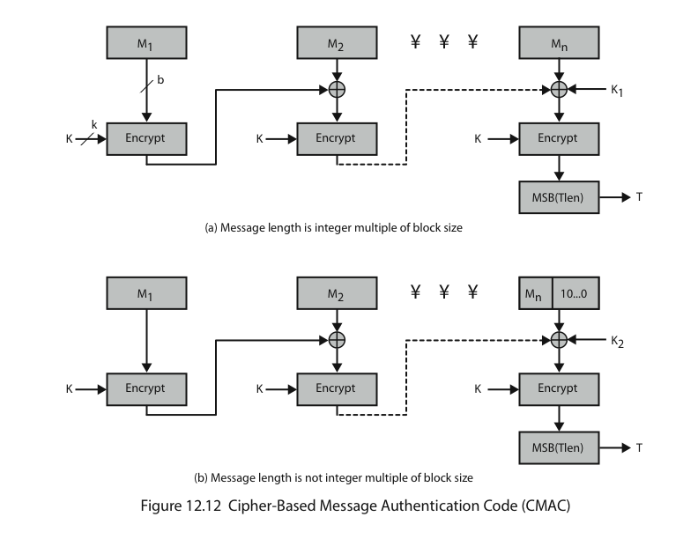
CMAC Overview
Notes:
Stallings Figure 12.12 shows the structure of CMAC.
It uses the blocksize of the underlying cipher (ie 128-bits for AES or 64-bits for triple-DES). The message is divided into n blocks M1..Mn, padded if necessary. The algorithm makes use of a k-bit encryption key K and an n-bit constant K1 or K2 (depending on whether the message was padded or not). For AES, the key size k is 128,192, or 256 bits; for triple DES, the key size is 112 or 168 bits. The two constants K1 & K2 are derived from the original key K using encryption of 0 and multiplication in GF(2^n), as detailed in the text.

Slide 22
Summary
have considered:
some current hash algorithms
SHA-512 & Whirlpool
HMAC authentication using hash function
CMAC authentication using a block cipher
Notes:
Chapter 12 summary.

